Slide 1


C-Roads Belgium

Slide 2
C-Roads Belgium/Flanders

Slide 3

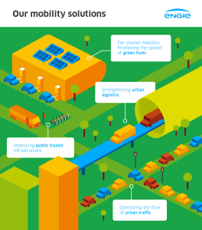








Tractebel in Smart Mobility
Future visions in mobility
Support in future business development
B2B advise in mobility solutions for employees
Mobility innovation partner in
EU-projects
City-level advise in deployment of smart mobility solutions
Smart mobility integration in smart city solutions
Strategic advise in future urban logistics

Slide 4

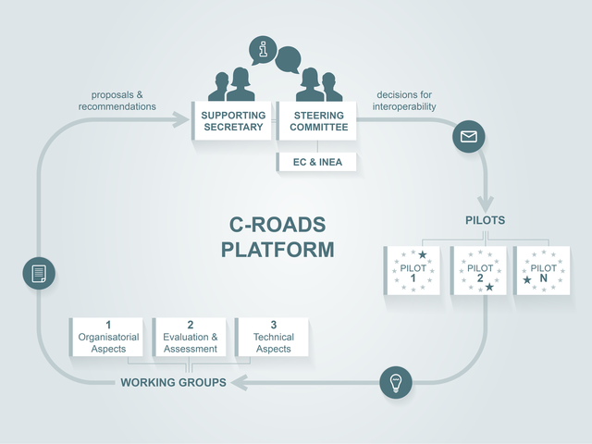
C-Roads platform
What?
  The C-Roads Platform is a cooperation of Member States and road operators working on the deployment of harmonised and interoperable C-ITS services in Europe.
How?
  The C-Roads Platform approach will pursue cooperation on a holistic level in order to cover all dimensions linked with the deployment of C-ITS.

Slide 5

The BelgiUM/FLANDERS project
Goal
  Roads Flemish pilot is to operate and assess the deployment of a cloud based ‘virtual infrastructure’ for an effective deployment of C-ITS services
Technology
  At the test site existing cellular based 3G-4G/LTE mobile communication networks will be used in combination with the HERE Location Cloud and the local Traffic Management Centre’s applications.

Slide 6
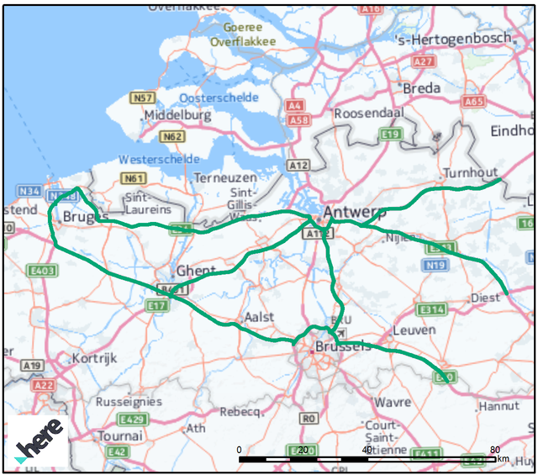



The BelgiUM/FLANDERS project
Region
  Flemish test area will concentrate on the (common) E34 – E313 segment East of Antwerp. As such motorways E34 (Antwerp – Eindhoven) and E313 (Antwerp – Liège) will be targeted for detailed evaluation purposes
Partners

Slide 7
Setup
Test-users
  1000 test drivers
Use cases
  C-Roads Flanders focuses on the following Day-1 Services including 10 use cases: 8 Hazards warnings and 2 signage applications:
  1) Temporarily slippery road 6) (Unprotected) Accident area
  2) Reduced visibility 7) Obstacle on the road
  3) Exceptional weather conditions 8) Traffic jam ahead warning
  4) (Fixed/stationary) Road works 9) Current speed limit
  5) Slow and stationary vehicle 10) Shockwave Damping based on Wide Moving Jam
Test-period
The test-period is 1 year (starts (March) 2019).

Slide 8
Call for participants
If your company is
  Near the test area
  Interested in new C-ITS technology
  Willing to test a market ready application with your employees
Contact
  Sven Vlassenroot
    Sven.vlassenroot@tractebel.engie.com
    Or you can give me your business card
  Or go to the HERE-booth to subscribe

Slide 9
C-Roads Belgium/WALLONIA

Slide 10
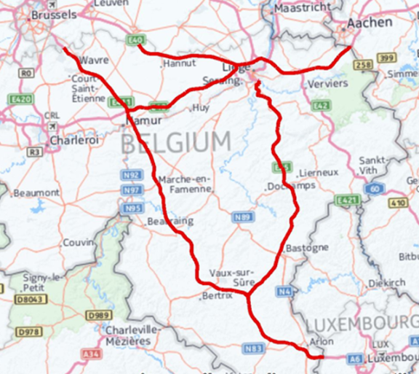



THE BelgiUM/WALLONIA PROJECT
Goal
  The pilot aim is to deploy and test C-ITS services using a cloud-based solution to connect road users to PEREX Traffic management center via a dedicated smartphone application using 3G/4G/LTE communication networks.
  The pilot will also include a limited number of road side units to test ITS-G5 communication and compare use cases testing.
Coverage
  Cellular: A3 (E40); A4 (E411); A26 (E25); A602 (E25/E40); A15 (E42)
  ITS G5: A602 (E25/E40)
Partners

Slide 11
THE BelgiUM/WALLONIA PROJECT
Day-1 Services
  Hazardous Location Notification – 7 use cases
    Accident zone, Traffic jam ahead, Stationary vehicle, Animal or person on the road, Weather condition warning, Wrong way driving
  Road Works Warning – 3 use cases
    Lane closure, Winter maintenance salting and ploughing
  In Vehicle signage – 1 use case
    Dynamic speed limit information
Day 1.5 Services
  Information on parking lots location and availability

Slide 12
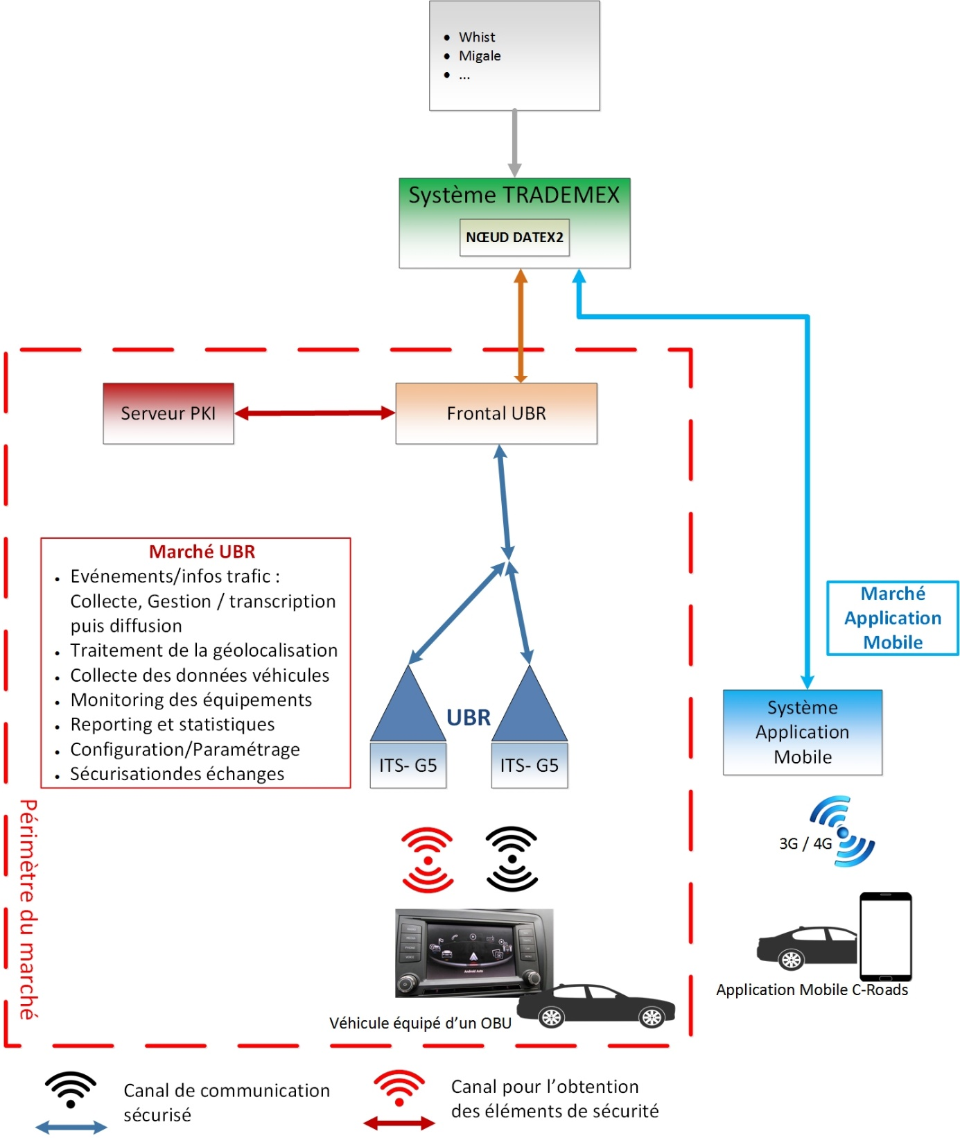
THE BelgiUM/WALLONIA PROJECT
Procurement « Mise en œuvre d’une infrastructure de véhicules connectés – projet pilote C-Roads »
  RSU Management system, RSU installation, PKI infrastructure, OBU
  To be published by end of October
Service Procurement for C-ITS services deployment via an external system with its dedicated smartphone application
  Private actor active in traffic or mobility services with existing app developments to be contracted
  To be published by end of the year

Slide 13
THE BelgiUM/WALLONIA PROJECT
Period
  Wallonia pilot starts 01/04/2019 until end of 2019
  1 or 2 additional use cases per month
Info, ideas or suggestions
  Contact: N. Leroy
  nicolas.leroy@spw.wallonie.be

